Slide 1



NYC
Story Telling Case Study
PPT - I

Slide 2
Agenda
1. | Objective
2. | Data Life Cycle
3. | Analysis Method
4. | Recommendations
5. | Data Methodology

Slide 3
Objective
Data Analysis Objective: Conduct a comprehensive analysis of the New York Airbnb dataset through effective questioning to extract actionable insights.
Question Framing: Develop precise, effective questions aimed at revealing vital information within the dataset.
Data Exploration: Utilize statistical and analytical techniques to delve deeply into the dataset, ensuring a complete understanding of its contents.
Visualization Techniques: Employ diverse graphical representations to visually showcase the insights extracted from the data.
Effective Communication: Utilize data visualization and analytical methods to effectively communicate the findings, ensuring clarity and actionable understanding for the audience.
Insightful Interpretation: Present the results in an actionable manner, enabling the audience to comprehend and act upon the insights gained from the New York Airbnb dataset.
Comprehensive Understanding: The goal is to provide a complete understanding of the dataset, derived insights, and their relevance for decision-making and strategic planning.

Slide 4
Data Life Cycle
Data Capture and Loading
Initially, data is captured and loaded into diverse environments or systems
Data Cleaning and Exploratory Data Analysis (EDA)
After the data is loaded, it undergoes a rigorous cleaning process to rectify inconsistencies, errors, and missing values. Following this, Exploratory Data Analysis (EDA) is conducted to understand the data distribution, patterns, and relationships.
Feature Engineering
New features are created through various techniques after an insightful EDA, thereby enhancing the dataset and potentially improving model performance.

Slide 5
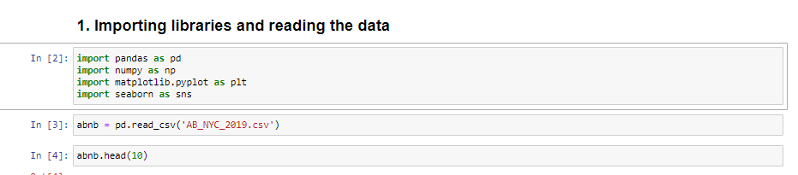
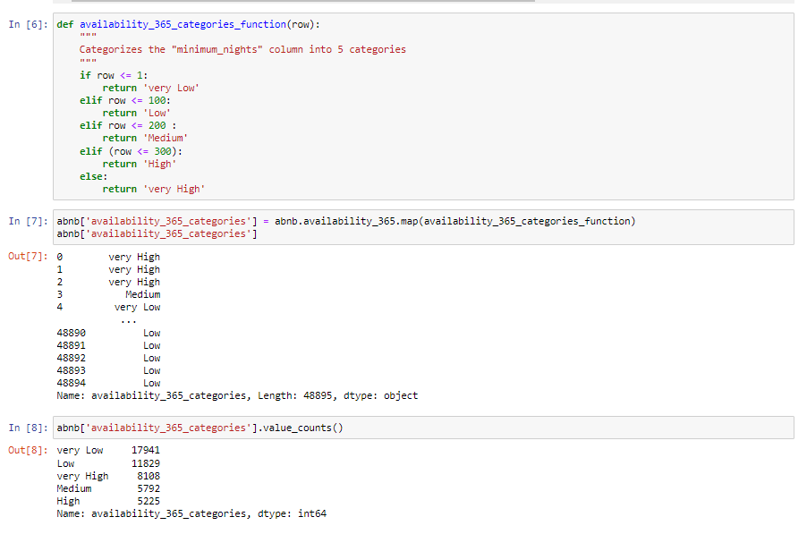
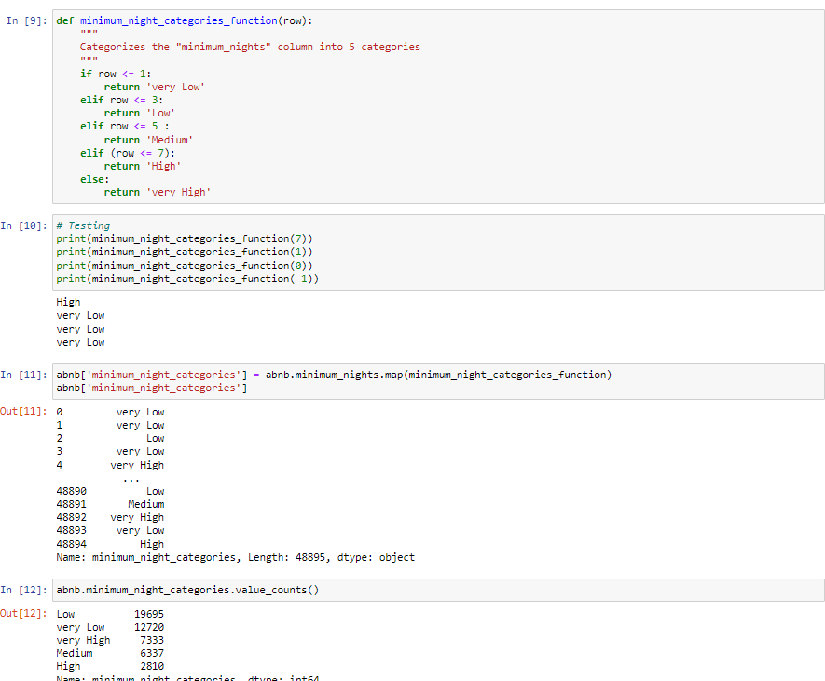
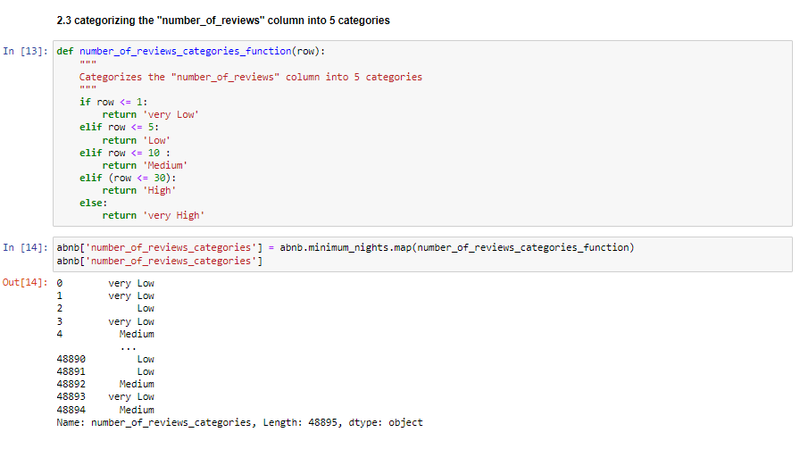
1. Data Capture and Loading
2. Feature Engineering

Slide 6
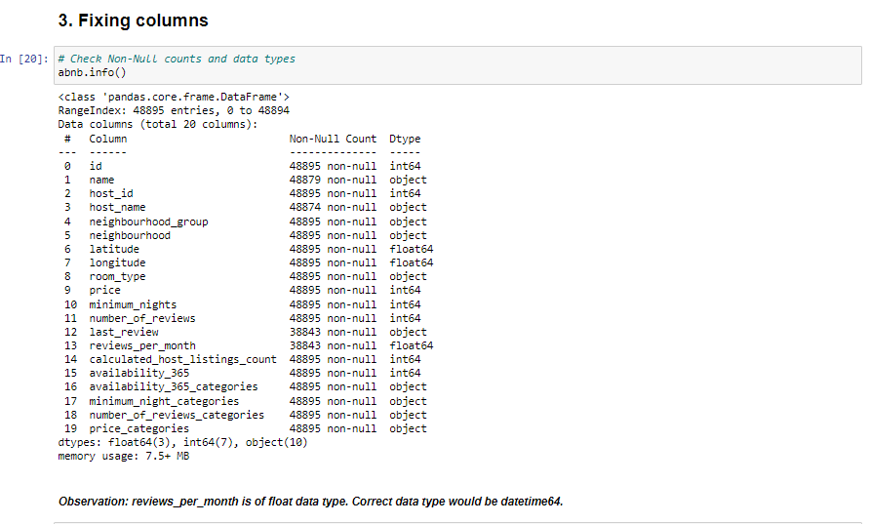
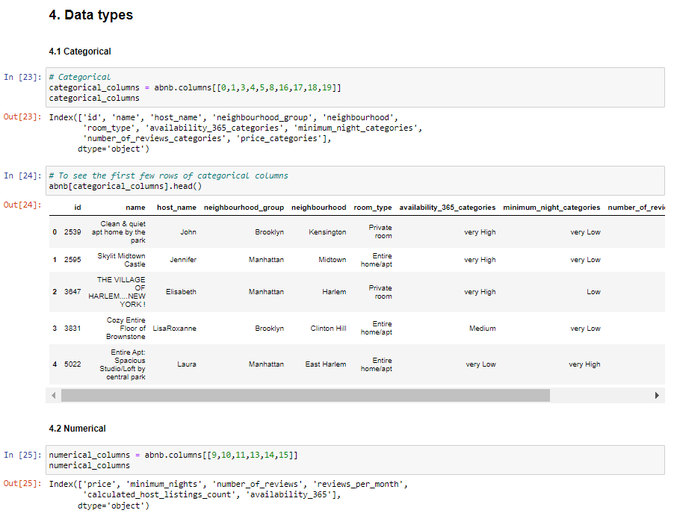
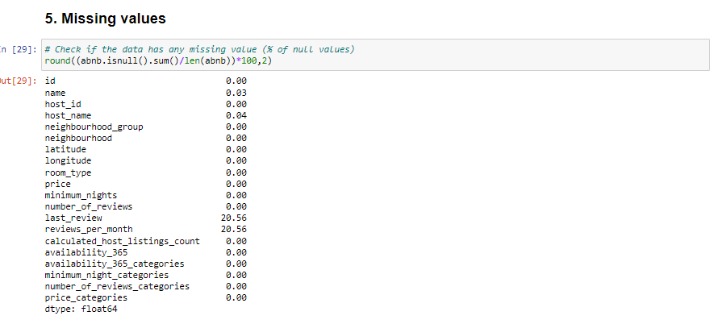
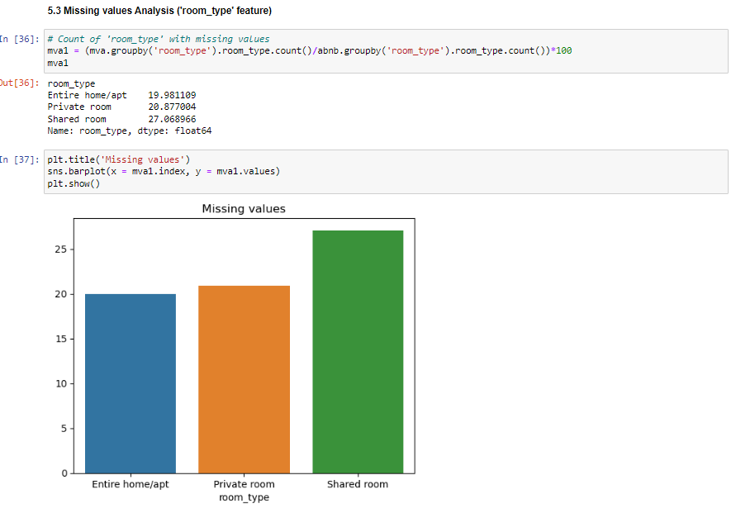
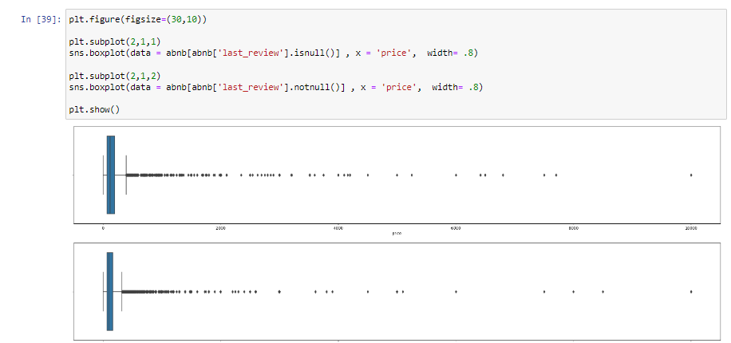
3. Data Cleaning and EDA

Slide 7
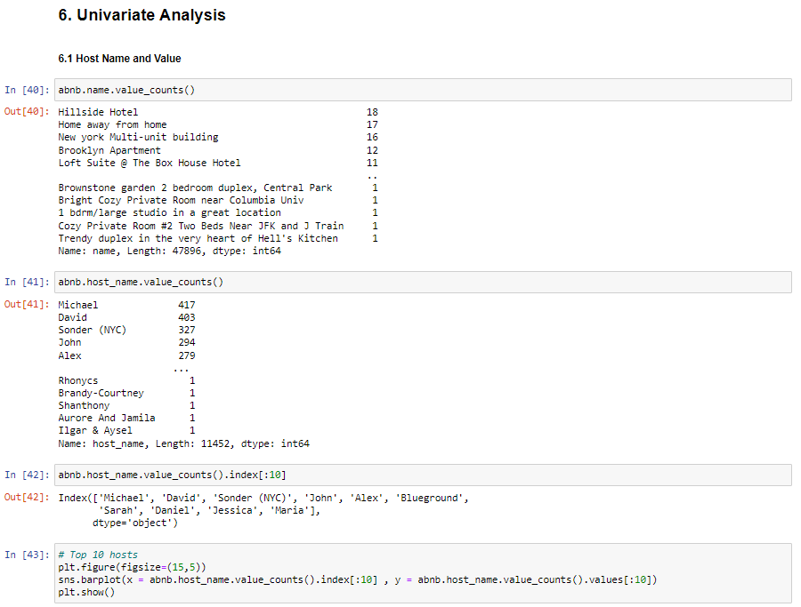
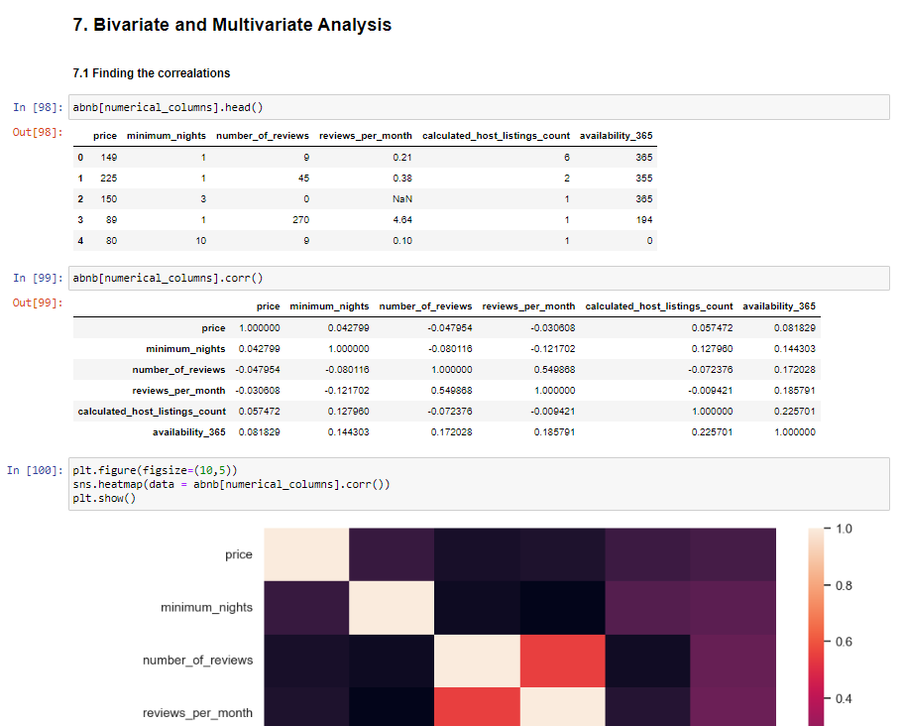
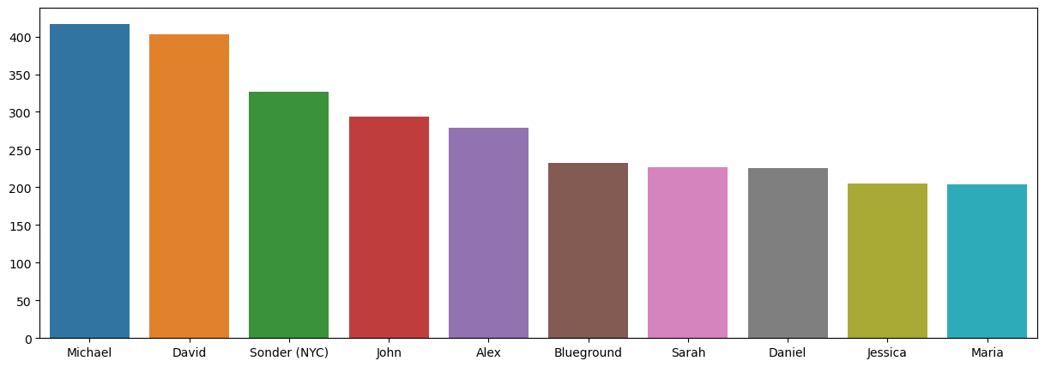
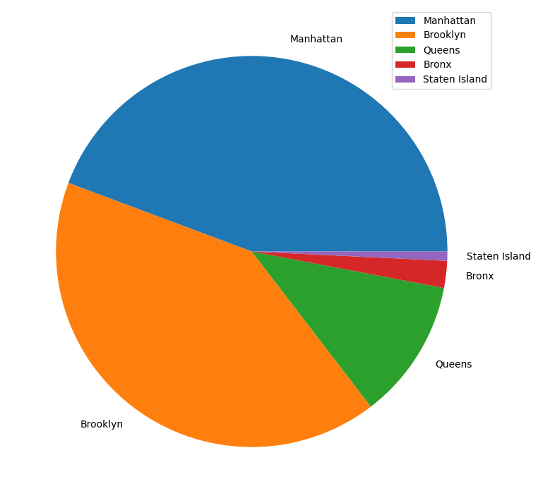
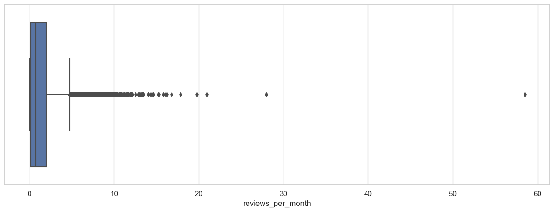
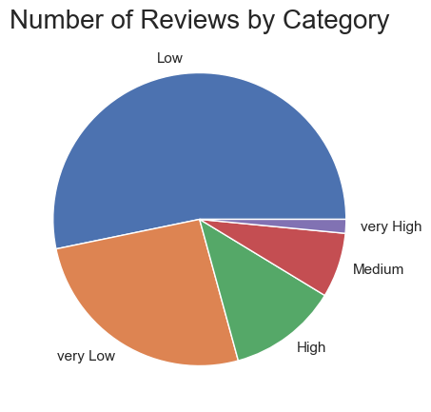
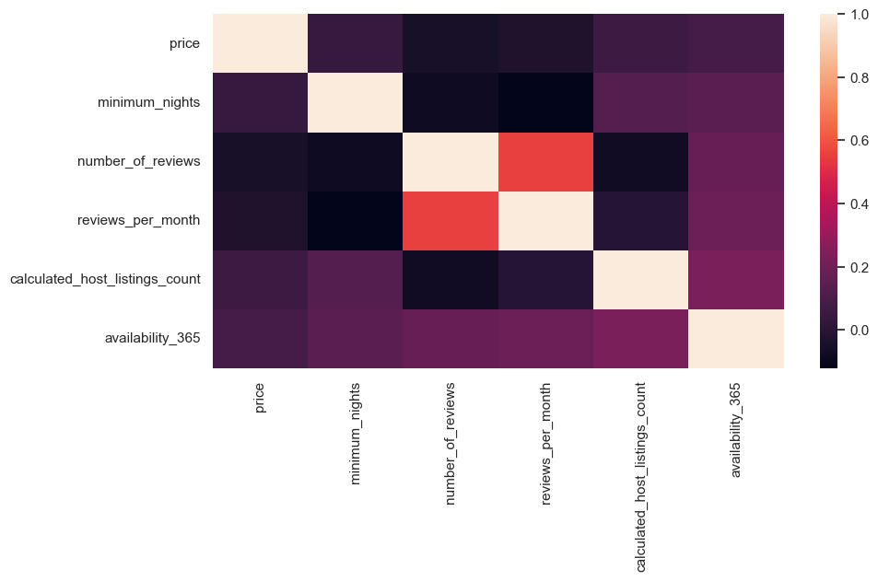
3. Data Cleaning and EDA (continued…)

Slide 8
Analysis Method
Data Collection and Loading:
Gathered and imported the Airbnb dataset, consisting of New York listings, into a working environment like Python using Pandas.
Ensured data readiness for analysis by loading it into a DataFrame for further processing.
Data Cleaning and Exploratory Data Analysis (EDA):
Performed data cleaning procedures to handle missing values and ensure data consistency.
Conducted EDA using statistical measures and visualization tools to comprehend distributions, relationships, and patterns within the dataset.
Feature Engineering:
Created new features from the available dataset, such as categorizing variables (e.g., 'availability_365' and 'minimum_nights') into distinct categories to gain more insights.
Statistical Techniques and Correlation Analysis:
Utilized statistical methods to establish correlations between variables within the dataset.
Examined correlations using tools like heatmap visualizations to identify key relationships and meaningful associations.
Categorical Analysis:
Analyzed categorical features to identify patterns and preferences, such as the 'room_type' distribution and preferences among users.
Visualization and Reporting:
Utilized various visualizations including histograms, box plots, pie charts, and bar plots to summarize and illustrate key findings for better comprehension.
Conclusion and Recommendation:
Summarized insights, conclusions, and any recommended actions based on the analysis conducted on the dataset

Slide 9
Recommendations
Price Adjustment: Adjust pricing strategies to align with the 'very low' or 'low' categories, which are more likely to attract reviews and potentially increase demand.
Property Diversification: Encourage more listings under 'Entire home/apt' categories as they are in high demand. Adjust existing listings or focus on acquiring similar properties.
Optimize Shared Room Listings: Enhance the appeal of shared rooms by either adjusting pricing strategies or introducing promotional activities to increase their traction.
Improve User Engagement: Optimize the property listings for better user experience to attract more customers. Highlight properties with high availability and competitive pricing to improve customer traction.

Slide 10
Data Methodology
Introduction
The methodology aims to conduct a comprehensive Exploratory Data Analysis (EDA) on the Airbnb NYC dataset. The dataset includes various features related to properties listed on Airbnb in New York City.
Data Collection and Preparation
Data Importing: Utilized Pandas library to read the dataset ('AB_NYC_2019.csv').
Data Understanding: Displayed the first few rows to gain an initial understanding of the data structure.
Feature Engineering and Categorization
Availability, Nights, Reviews, and Pricing Categories: Categorized columns including 'availability_365', 'minimum_nights', 'number_of_reviews', and 'price' into five distinct categories using defined conditional functions.
Data Cleaning and Column Adjustments
Data Type Corrections: Transformed the 'last_review' column to 'datetime64' data type.
Column Adjustments: Identified categorical, numerical, coordinates, and date columns and displayed their content for a preliminary understanding.
Missing Values Analysis
Evaluation of Missing Values: Investigated the presence of missing values in columns, specifically focusing on 'last_review' and 'reviews_per_month' columns.

Slide 11
Data Methodology
Univariate Analysis
Exploration of Features: Analyzed individual features including 'host_name', 'neighbourhood_group', 'price', 'minimum_nights', 'number_of_reviews', 'reviews_per_month', 'calculated_host_listings_count', and 'availability_365'.
Visualization: Utilized various visualizations such as bar plots, box plots, histograms, and pie charts to understand the distributions and characteristics of different features.
Bivariate and Multivariate Analysis
Correlation Analysis: Explored correlations among numerical columns using correlation matrices and visualizations.
Top Correlations: Identified and examined top meaningful correlations within the dataset.
Relationship Analysis: Studied the relationships between room types, number of reviews, prices, and availability for further insights.
Data Saving
Export of Updated Data: Saved the manipulated dataset to 'AB_NYC_2019_updated.csv' after categorization and adjustments.
Conclusion and Recommendations
Insights: Derived insights into the impact of various categories on prices, reviews, and customer preferences.
Recommendations: Suggested adjustments such as keeping minimum nights lower, modifying prices for higher availability, and understanding property features more customer-oriented.

Slide 12
Data Methodology
Implications
This methodology provides a foundation for making data-driven decisions and more in-depth analyses related to Airbnb's business operations.
Further Steps
The methodology serves as a basis for future advanced analyses, predictive modelling, and strategic decision-making in the context of Airbnb's property listings.

